Slide 1
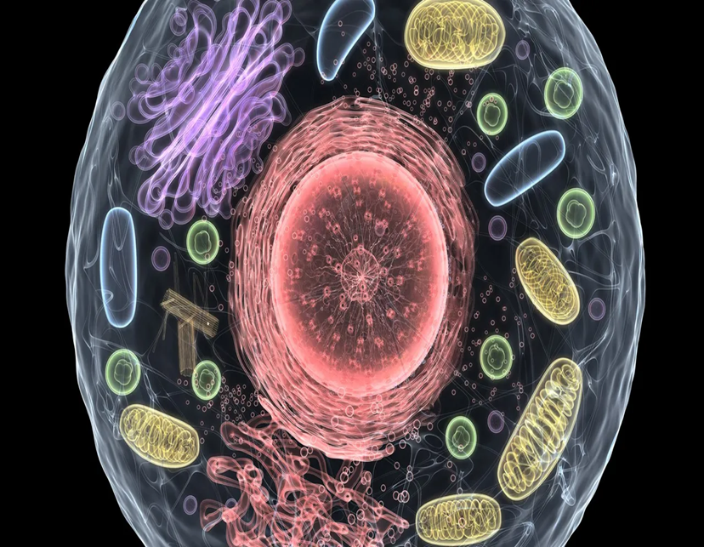
Eukaryotic Cells
Presented by Dr. Aouati Amel

Slide 2
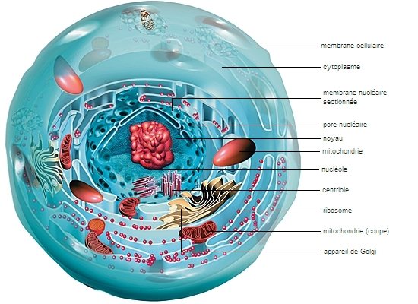
A eukaryotic cell has a true nucleus bounded by a nuclear envelope containing genetic material (DNA), and a highly structured cytoplasm containing specific organelles.
It is bounded by a plasma membrane that separates it from the external environment and limits the cytoplasm.

Slide 3
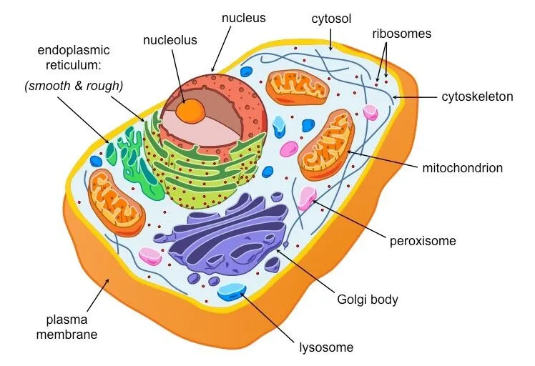
Eukaryotic Cell Structure Overview

Slide 4
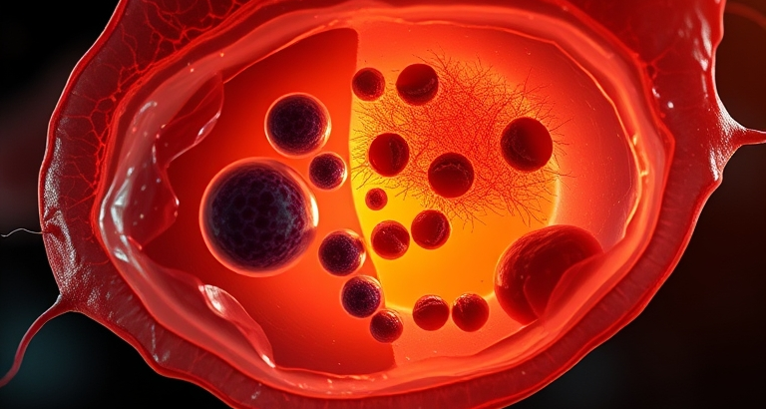
Components of eukaryotic cells
Cytoplasm - Cellular Matrix
The eukaryotic cell is bounded by a plasma membrane and contains a nucleus and cytoplasmic organelles.
The Protoplasm represents the contents of a living cell, including the cytoplasm and the nucleus.
The Cytoplasm includes hyaloplasm and organelles.
The Hyaloplasm is a transparent structure that supports organelles; it includes the cytosol and the cytoskeleton.
The Cytosol is a solution, rich in water, proteins, sugars, and ions; it has a homogeneous and transparent appearance.

Slide 5
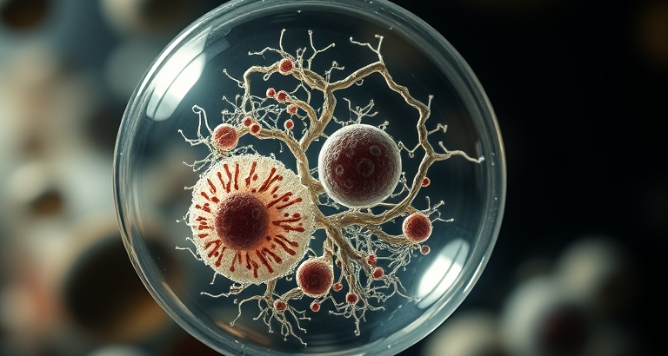
Nucleus - The Control Center
The Nucleus: is the most visible organelle under the microscope, it’s rounded and delimited by the nuclear envelope. It contains most of the cell's genetic material (DNA).

Slide 6
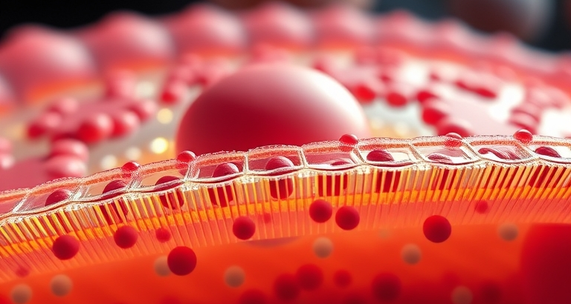
Cell Membrane - Protective Barrier
The plasma membrane: is consists of a double layer of lipids, proteins and carbohydrates.
It constitutes a fluid selective barrier but at the same time watertight selective barrier isolating the cell from the external environment.

Slide 7
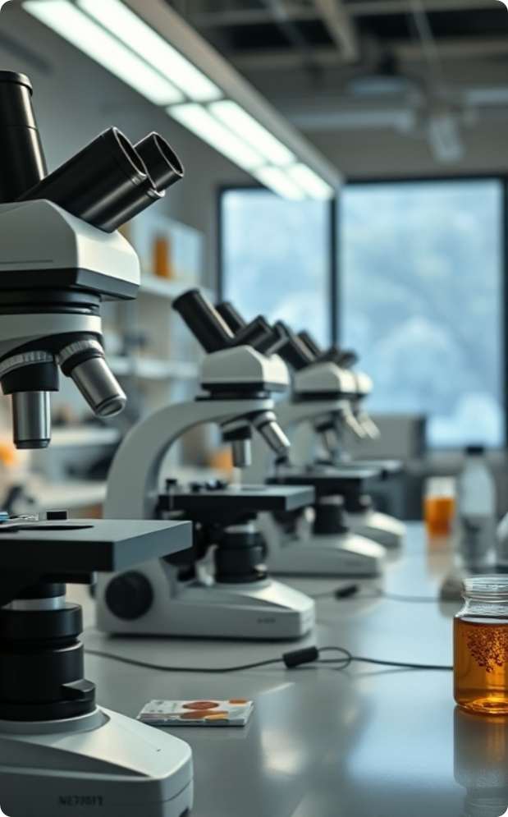
The Lysosomes: are organelles bounded by membrane and containing enzymes necessary for cellular digestion.
The Peroxisomes: are spherical organelles whose principal role is cellular detoxification.
The cytoskeleton: is a network composed of three types of protein fibers: microtubules, intermediate filaments, and actin microfilaments. these three fibers ensures fundamental roles in the structure and movement of the cell and its organelles.
The mitochondrion: is an organelle, delimited by two membranes: one outer and smooth, and the other inner, forming the cristae. In addition to containing mitochondrial DNA, it ensure an essential role in the production of ATP.

Slide 8
The endoplasmic reticulum is a membrane system composed of flattened, communicating cavities that sometimes contain ribosomes. There are two types of reticulum: the rough endoplasmic reticulum, which is characterized by the presence of ribosomes attached to the outer surface of the reticular membrane, and the smooth endoplasmic reticulum, which does not contain any ribosomes on its surface. Both types perform several physiological functions, such as protein and lipid synthesis, drug detoxification, and calcium storage.
The Golgi apparatus is a membrane system formed by a stack of flattened saccules or cisternae. By receiving vesicles from the rough endoplasmic reticulum containing proteins, it modifies their structure by adding carbohydrate residues (e.g., N-glycosylation), thus ensure an essential role in protein synthesis.

